Slide 1
Handling Numerical and Categorical Data with Python - Pandas

Slide 2
Course outline
Analyze various ways to deal with numerical and categorical data in Python ( Module: pandas)
Discuss the differences between numerical and categorical data
Use Python modules to rescale a feature in numerical data sets
Discuss outliers and various ways to detect them
Use Python modules to discretize a feature
Use Python modules to cluster observations
Use Python modules to address missing values
Use Python modules to encode nominal categorical values
Use Python modules to encode ordinal categorical values

Slide 3

Contents
Types of Data
Feature Scaling
Data Discretization
Outliers and detection
Clustering Observations
Handling Missing Values
Encoding Categorical Values

Slide 4
Types of Data
While collecting data or working with data, it is important to know the format of data to analyze or interpret insights from it.
There are mainly two kinds of textual data which we want to investigate while considering any textual data handling or machine learning.
Numerical Data
Categorical Data
It is important to identify both based on their differences and similarities.

Slide 5
Numerical Data
Numerical Data, as the name suggests it contains numbers and not in any language or descriptive format.
It is often referred to as quantitative data.
Numerical data is collected in number form and stands different from any form of number data types due to its ability to be statistically and arithmetically calculated.
There are two sub types of numerical data:
Continuous data
Discrete Data

Slide 6
Numerical Data
Discrete Data is nothing but representation of countable items, amounts frequencies etc
Discrete data basically takes countable numbers like 1, 2, 3, 4, 5, and so on. In the case of infinity, these numbers will keep going on.
Continuous data, as the name speaks it has data in the form of intervals or ranges
Continuous numerical data represent measurements, and their intervals fall on a number line. Hence, it doesn’t involve taking counts of the items.
It can be further divided into interval data and ratio data

Slide 7
Categorical Data
As the name suggests, it refers to data type that is based on a category or grouping
Categorical data refers to a data type that can be stored and identified based on the names or labels given to them.
The data collected in the categorical form is also known as qualitative data.
Each dataset can be grouped and labelled depending on their matching qualities, under only one category. This makes the categories mutual exclusive.
Height of a person is categorical data, as a person can only be tall, short etc

Slide 8
Categorical Data
There are two subtypes of Categorical Data namely
Nominal Data:
This is also called as named data
Nominal data is defined as data that is used for naming or labelling variables, without any quantitative value. Nominal data is non-parametric and doesn’t have a proper order
Note that the nominal data examples are nouns, with no order to them
Race is a nominal variable having a number of categories, but there is no specific way to order from highest to lowest

Slide 9
Categorical Data
Ordinal Data:
Includes data or elements of data that is ranked, ordered or used on a rating scale.
You can count and order ordinal data, but it doesn’t allow you to measure it.
The variables in ordinal data are listed in an ordered manner.
The ordinal variables are usually numbered, to indicate the order of the list.
However, the numbers are not mathematically measured or determined but are merely assigned as labels for opinions.

Slide 10
Feature Scaling
Numerical data generally has numbers in different ranges.
The dataset containing height in cms and weight in kilograms might mislead the model as the height values average around 175 whereas weight around 50 making model biased towards the height feature
To avoid these, we scale the data into a common range for all the features. For example, all the heights will be scaled such that they fall in the range 0-1 and same goes with weight.
There are two most common techniques of scaling numerical data namely Min-Max Normalization and Standardization

Slide 11
Min Max Normalization
Here all the values are scaled such that they are in the range [0,1].
0 is the minimum value and 1 is the maximum value
A value can be normalized by Min Max Normalization using the formula
Y = ( X – Min ) / ( Max – Min )
It is useful to scale the input attributes for a model that relies on the magnitude of values, such as distance measures used in k-nearest neighbors and in the preparation of coefficients in regression.
Min Max normalization can be done using Pandas module in Python

Slide 12
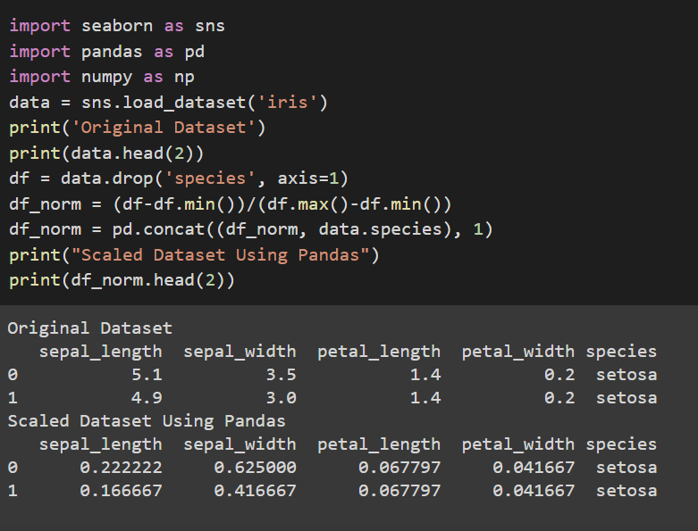
Min Max Normalization
Inbuilt Iris data is loaded
We will drop the species column because it has categorical data.
The data is normalized using Min Max Normalization logic and the Species is then concatenated to respective record
Data is normalized between [0,1]

Slide 13
Standardization
Here all the values are scaled such that they are in the range [0,1].
Standardization doesn’t have any fixed minimum or maximum value.
It can be computed using the formula
Y = ( X – Mean ) / ( Standard Deviation )
Here, the values of all the columns are scaled in such a way that they all have a mean equal to 0 and standard deviation equal to 1.
This scaling technique works well with outliers. Thus, this technique is preferred if outliers are present in the dataset.

Slide 14
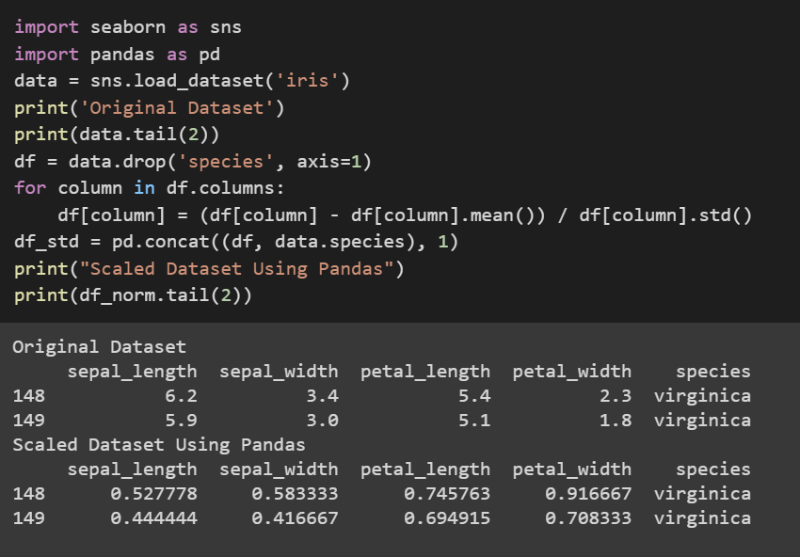
Standardization
Inbuilt Iris data is loaded
We will drop the species column because it has categorical data.
Here data should be computed column by column because we use mean and standard deviation of respective columns for scaling
Data is normalized between [0,1]

Slide 15
Data Discretization
Data discretization is the process of converting continuous data into discrete buckets by grouping it. Discretization is also known for easy maintainability of the data.
Some famous methods of data discretization are binning and using a histogram.
Although data discretization is useful, we need to effectively pick the range of each bucket.
The main challenge in discretization is to choose the number of intervals or bins and how to decide on their width.

Slide 16
Data Discretization
Pandas supports these approaches using the cut and qcut functions.
qcut is a “Quantile-based discretization function.” qcut tries to divide up the underlying data into equal sized bins. The function defines the bins using percentiles based on the distribution of the data, not the actual numeric edges of the bins.
cut is used to specifically define the bin edges. There is no guarantee about the distribution of items in each bin. In fact, we can define bins in such a way that no items are included in a bin or nearly all items are in a single bin.

Slide 17
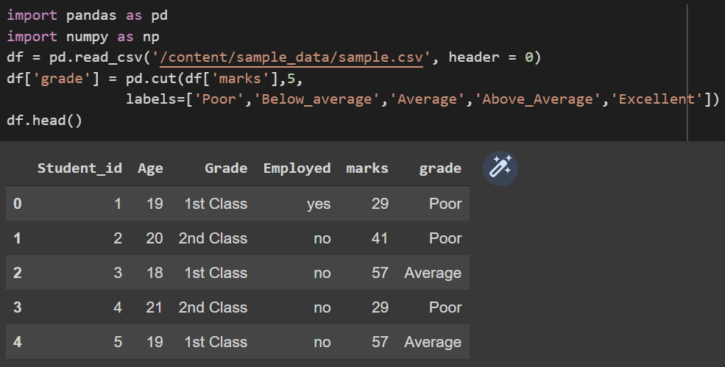
Data Discretization
The data is discretized into grades based on the marks. Here we are using 5 labels and 5 bins. The ranges of values in the bins are automatically computed.

Slide 18
Outliers
In a dataset there are some data items/ objects/ numbers which deviate from the so-called normal items/objects/numbers. These are called outliers
For example, if we are looking into heights data in feet normal heights range in between 4 to 7. Suppose we had a value which is 20, this is an outlier
They can be caused by measurement or execution errors.
The analysis for outlier detection is referred to as outlier mining. There are many ways to detect the outliers, and the removal process is same as removing a data item from the panda’s data frame.

Slide 19
Outliers Detection
There are many ways to detect outliers such as
Visualization
Using Mathematical Formulas on data set such as Standardization
Statistical Approach
The basic way to find out whether there are any outliers in the data is by visualization.
First, we plot graphs for the columns to look whether there are any outliers. By looking at the plots we can make sure outliers are present and decide on how to handle them.

Slide 20
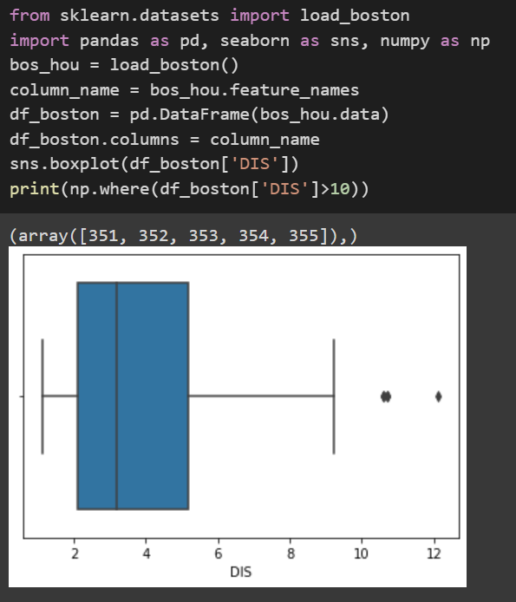
Outliers Detection
Box plot is the best plot to locate outliers in data. We can also use scatter plot.
Here we are using preloaded Boston houses dataset. We are plotting a box plot for the DIS values in the dataset
It is evident that values above 10 are outliers
To get the outliers indices we filter out values greater than 10.

Slide 21
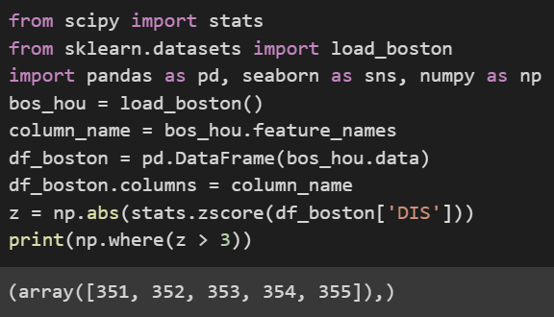
Outliers Detection – Z score
Z- Score is also called a standard score. This value/score helps to understand that how far is the data point from the mean. And after setting up a threshold value one can utilize z score values of data points to define the outliers.
Now to define an outlier threshold value is chosen which is generally 3.0. As 99.7% of the data points lie between +/- 3 standard deviation (using Gaussian Distribution approach).

Slide 22
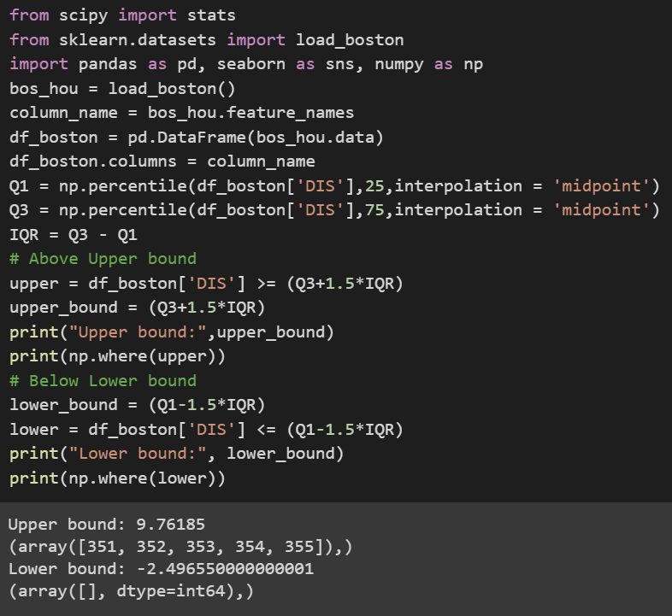
Outliers Detection – Inter Quartile Range
IQR = Quartile3 – Quartile1
To define the outlier base value is defined above and below datasets normal range namely Upper and Lower bounds, define the upper and the lower bound (1.5*IQR value is considered) :
upper = Q3 +1.5*IQR
lower = Q1 – 1.5*IQR

Slide 23
Clustering Observations
Clusters analysis or clustering is an unsupervised learning algorithm
There are many different clustering algorithms and no single best method for all datasets
A cluster is often an area of density in the feature space where examples from the domain (observations or rows of data) are closer to the cluster than other clusters. The cluster may have a center (the centroid) that is a sample or a point feature space and may have a boundary or extent.
There are many clustering algorithms but most popular is K-Means

Slide 24
Handling Missing Values
Data Cleaning is the most time-consuming part of any data science project
Missing values are nothing but blank or null values present in the dataset.
However, there are many powerful tools to expedite this process. One of them is Pandas which is a widely used data analysis library for Python.
Missing values can be handled in two ways
Dropping the null values or missing value records
Replacing the null values

Slide 25
Handling Missing Values
Dropping the null values might be feasible in some situations, but its not feasible if there are many missing values. For example we consider a data set where there are 3 columns and 10 rows. There are 3 records missing in column 1, 3 in column 2 and 4 in column 3 which are all mutually exclusive.
If this is the case, we can’t remove all records because it leaves us with 0 records
Then we are left with nothing but replacing null values. Null values can be replaced in many ways such as replacing with mean, median, preceding value, next value, some random value or by interpolation etc

Slide 26
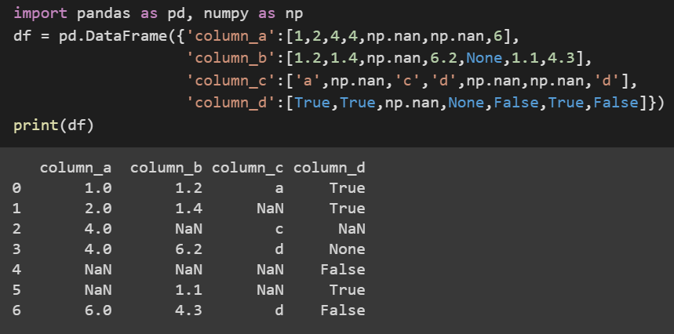
Handling Missing Values
Let’s create a data frame with missing values and investigate different possible ways to handle the missing values. np.nan, None and NaT (for datetime64[ns] types) are standard missing value for Pandas
Pandas Provides isnull() and isna() functions to detect the null values.
We can drop missing values in pandas using the function dropna()

Slide 27
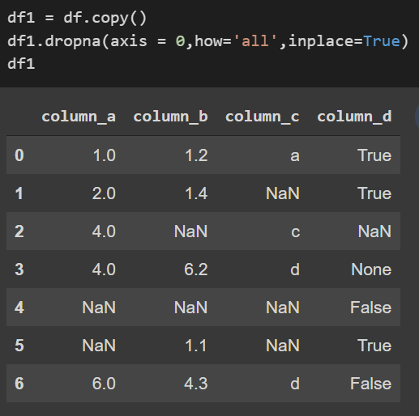
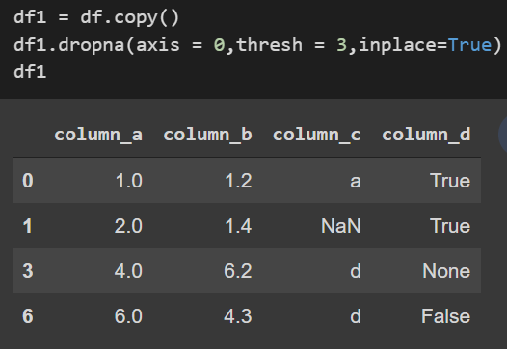
Handling Missing Values
How parameter is used to set condition to drop.
how=’any’ : drop if there is any missing value
how=’all’ : drop if all values are missing
axis parameter is used to select row (0) or column (1).
Our data frame do not have a row with full of missing values so setting how=’all’ did not drop any row.
Setting thresh parameter to 3 dropped rows with at least 3 missing values.

Slide 28
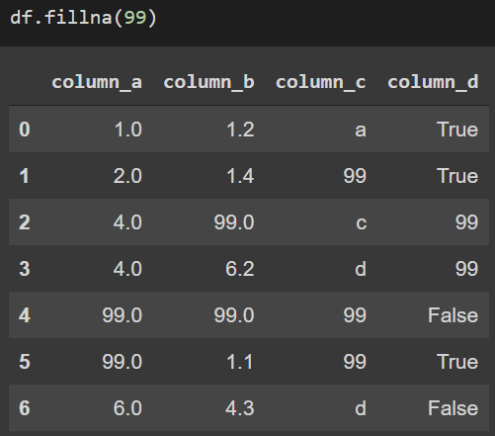
Handling Missing Values
Another way to handle missing values is by replacing the missing values with some random number, mean, previous row value, next row value , median, interpolation etc
Pandas provides fillna() method to fill missing values
Instead of filling with number 99 it can also be filled with
Mean as: df.fillna(df.mean())
Using method parameter, missing values can be replaced
with the values before or after them

Slide 29
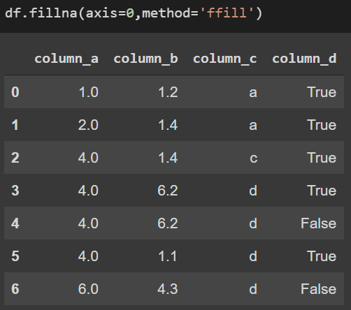
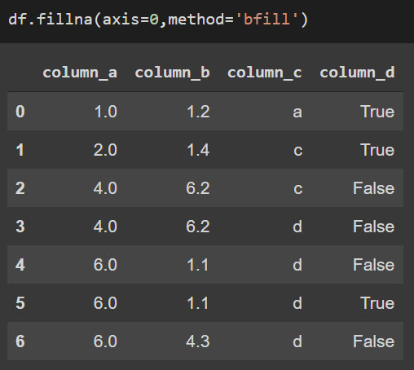
Handling Missing Values
ffill stands for “forward fill” replaces missing values with the values in the previous row.
bfill stands for “backward fill” replaces missing values with the values in the next row.

Slide 30
Encoding Categorical Values
Categorical valued columns have data in text categories which cannot be fed into the machine learning algorithms.
Sometimes in datasets, we encounter columns that contain categorical features (string values) for example parameter Gender will have categorical parameters like Male, Female. These labels have no specific order of preference and since the data is string labels, the machine learning model can not work on such data.
Hence we encode these columns into some split of columns with numerical data.
Common methods are one hot encoding and label encoding

Slide 31
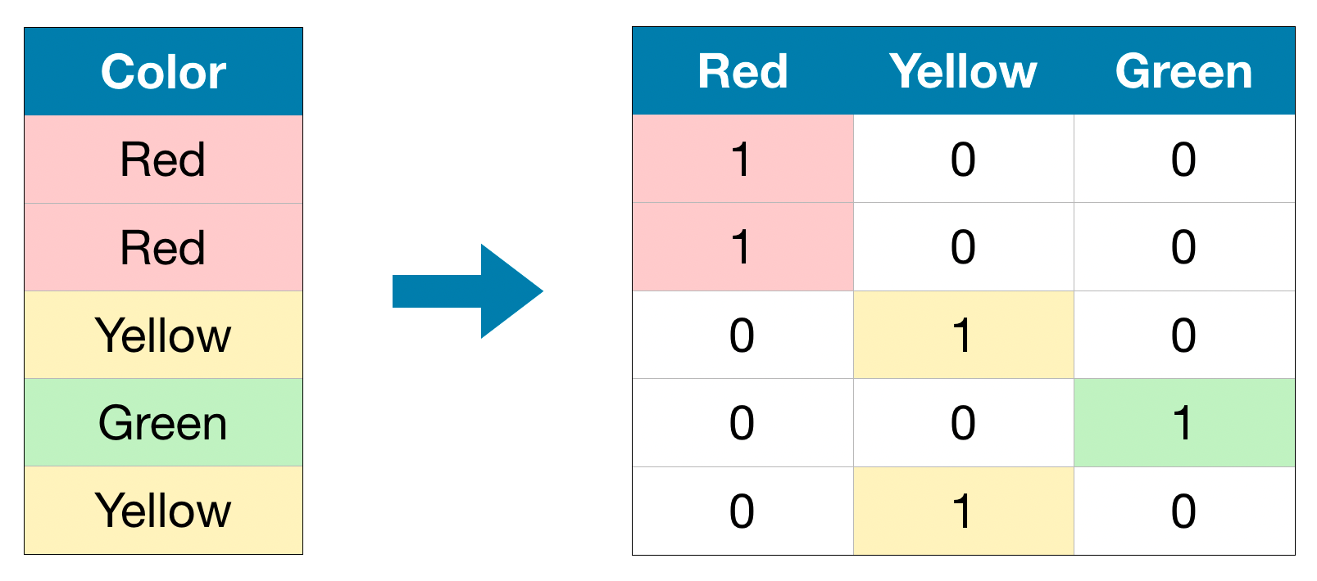
Encoding Nominal Categorical Values
One hot encoding can be applied on nominal categorical variables
One hot encoding allows us to turn nominal categorical data into features with numerical values while not mathematically imply any ordinal relationship between classes
Source : web

Slide 32
One Hot Encoding
A one hot encoding is a representation of categorical variables as binary vectors. This first requires that the categorical values be mapped to integer values.
Then, each integer value is represented as a binary vector that is all zero values except the index of the integer, which is marked with a 1.
we need encoding methods to convert non-numerical data to meaningful numerical data. For this we look at Pandas get_dummies method.
get_dummies is one of the easiest way to implement one hot encoding method and it has very useful parameters, of which we will mention the most important ones.
You can perform one hot encoding in just one row with get_dummies

Slide 33
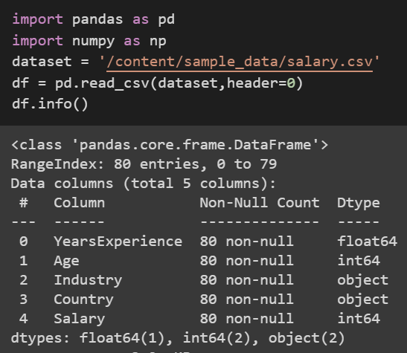
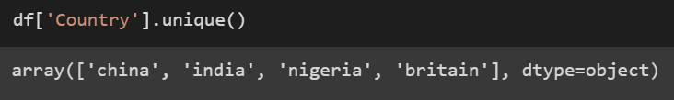
One Hot Encoding
Let's take a sample dataset which has salaries of different countries and industries
We can see that the Columns Industry and Country have data type as object indicating them to be categorical valued columns
Let’s continue with Country column, it has four distinct values as shown below.

Slide 34
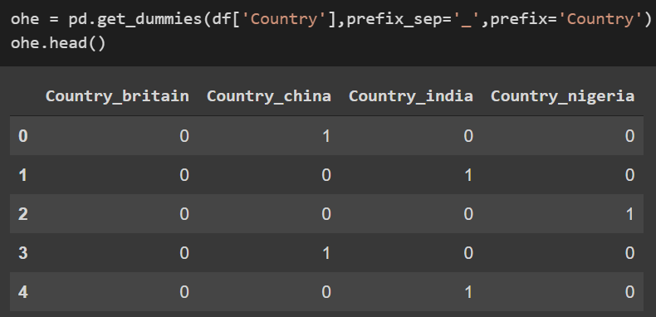
One Hot Encoding
The “country” column has four unique values, which means we will get four columns after applying get_dummies().
With this syntax we can apply get_dummies to dataframe’s column
df[‘country’] = target categorical column from our dataset
prefix_sep = prefix separator parameter for clean column name
prefix = prefix values for our new columns
We can see the country column getting split into 4 separate countries with vector numerical mappings

Slide 35
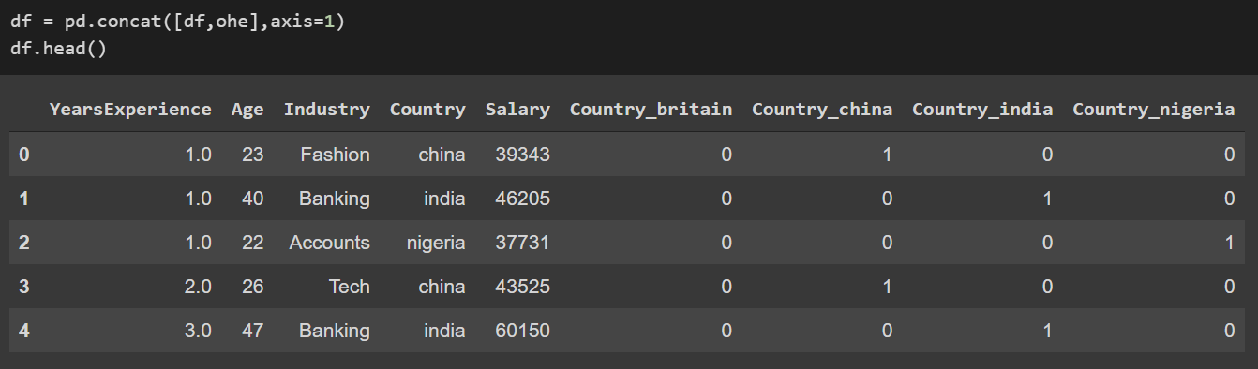
One Hot Encoding
Our original data frame, df keeps its shape. We must merge these dataframes.
We can merge them in two ways using join or concat.
Next step will be dropping the Country column from the dataset

Slide 36
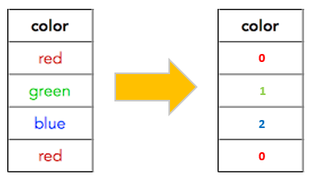
Encoding Ordinal Categorical Values
Label encoding is applied on ordinal categorical values
Label Encoding refers to converting the labels into a numeric form so as to convert them into the machine-readable form
Source : web

Slide 37
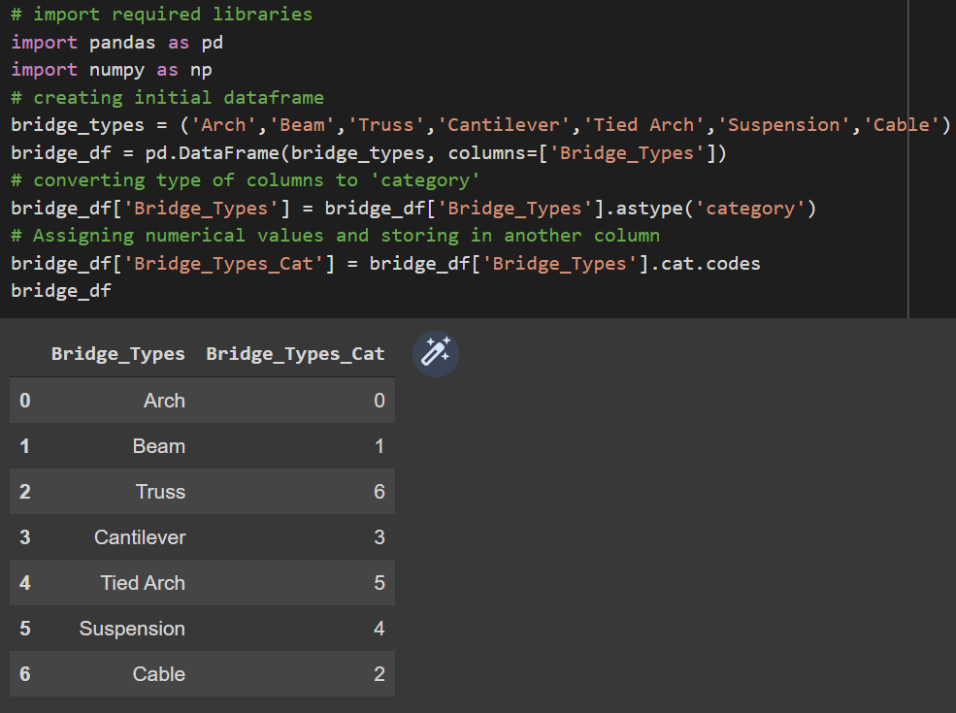
Label Encoding
Let’s create a sample data set assuming these are the different kinds of categories present in an ordinal variable in some dataset
Lets apply label encoding on the data to create a column which is the numerical representation of each label

Slide 38
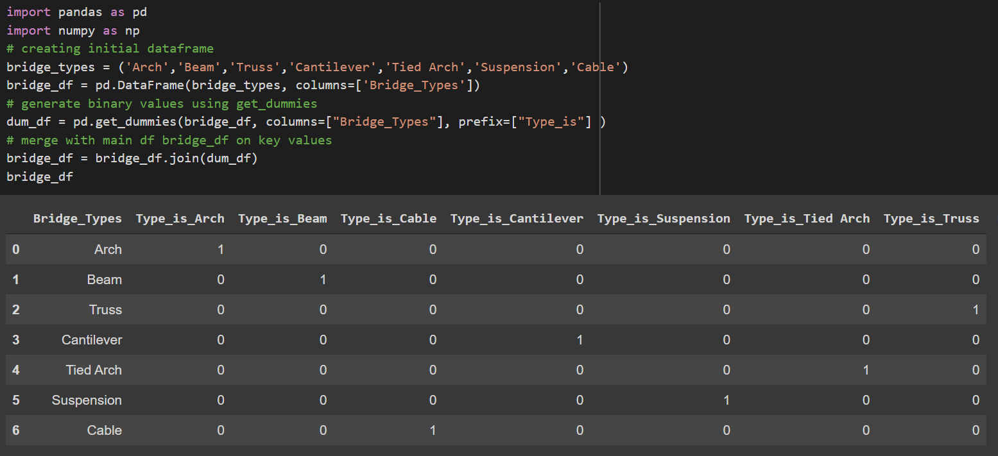
One hot encoding on the same previous data gives the following output where each column for separate value in the categorical variable is created with vector Boolean mapping

Slide 39
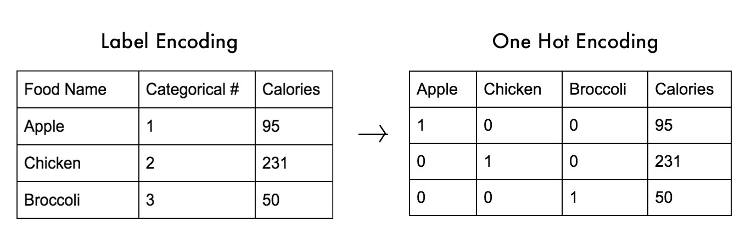
Label Encoding vs One Hot Encoding
In label encoding we will be replacing 1 with Appple and 2 with chicken etc. This will lead to a single numerically encoded column. Whereas in one-hot encoding, we end up with new columns. One-hot encoding takes a column with categorical values and then splits the column into multiple columns
Source : web

Slide 40
Assignment
In the attached sample.csv dataset fill the missing values using the Interpolation of data in all the columns
Apply one hot encoding to the Industry column in the salary.csv file which is used in One hot encoding practice slides
Apply Label encoder for both country and industry column for salary.csv dataset
Discretize the data into different age bins using the salary dataset Age column

Slide 41
Summary

Slide 42
Q&A

